Slide 1
Comprehensive Data Profile
Welch Elementary School

Slide 2
Welch Elementary School Introduction
Welch Elementary School is in Newnan, Georgia. It is part of Coweta County School System.
Welch Elementary School serves approximately 876 students in grades Pre-K through five.
Welch Elementary School has 37.5 percent of the students economically disadvantaged and 12.5 percent of students with disabilities. Additionally, Welch Elementary serves 10.6% English Language Learners.
Welch Elementary School’s overall content mastery is 4.3 percent points lower than its district. Its student readiness is just below the district’s percent points.
The 2019 CCRPI score was 76.2% compared to the district (84.8%) and state (75.9%).
Welch Elementary School has a 5-star School Climate Rating.
School grades. Data source retrieved from https://public.gosa.ga.gov/noauth/extensions/SchoolGrades-Georgia/SchoolGrades-Georgia.html?lang=English&SchoolName=welch-elementary-school

Slide 3
Demographic Data

Slide 4
321
293
304
295
287
292
269
269
266
266
270
266
258
250
262
260
244
233
Number of Students
Grade Level
Fall and Spring school enrollment data by grade level. Data source retrieved from https://gaawards.gosa.ga.gov/analytics/saw.dll?dashboard

Slide 5
41
42
41
37
Percentage of Students
34
34
15
15
15
6
6
5
3
4
4
Race/Ethnicity
Fall and Spring school enrollment data by grade level. Data source retrieved from https://gaawards.gosa.ga.gov/analytics/saw.dll?dashboard

Slide 6
54
49
Percentage of students
33
10
11
11
10.5
10.8
3
Subgroups
Fall and Spring school enrollment data by grade level. Data source retrieved from https://gaawards.gosa.ga.gov/analytics/saw.dll?dashboard

Slide 7
66
68
64
61
60
6
6
7
2
2
2
Demographics
Fall and Spring school enrollment data by grade level. Data source retrieved from https://gaawards.gosa.ga.gov/analytics/saw.dll?dashboard

Slide 8
Achievement Data

Slide 9
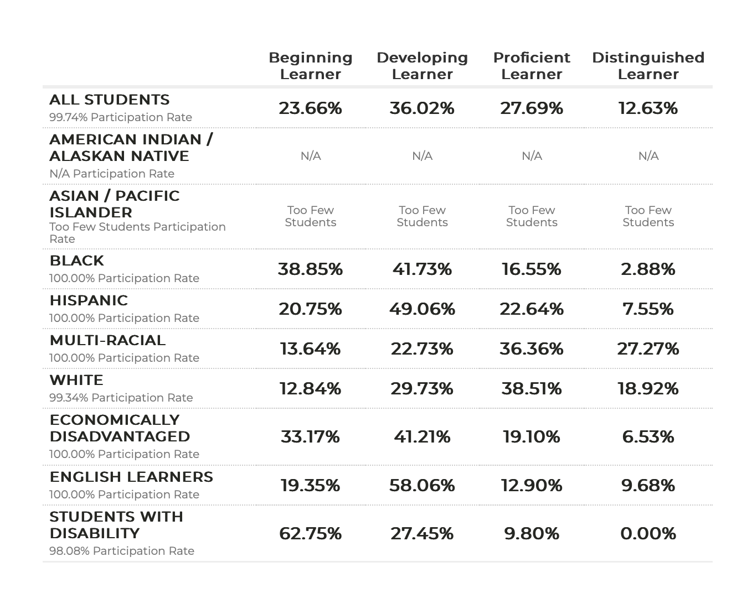
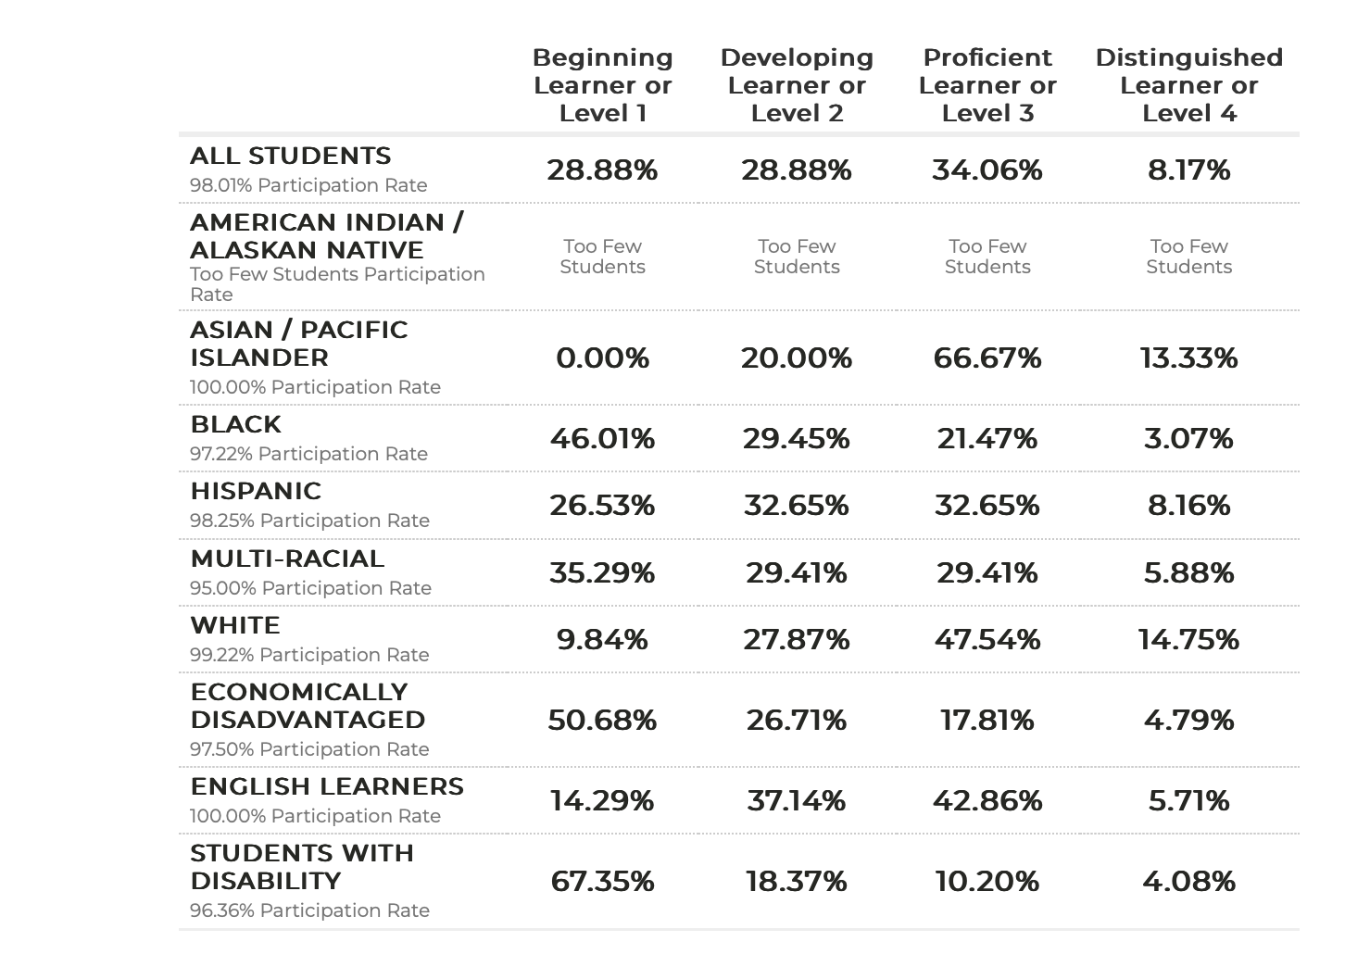
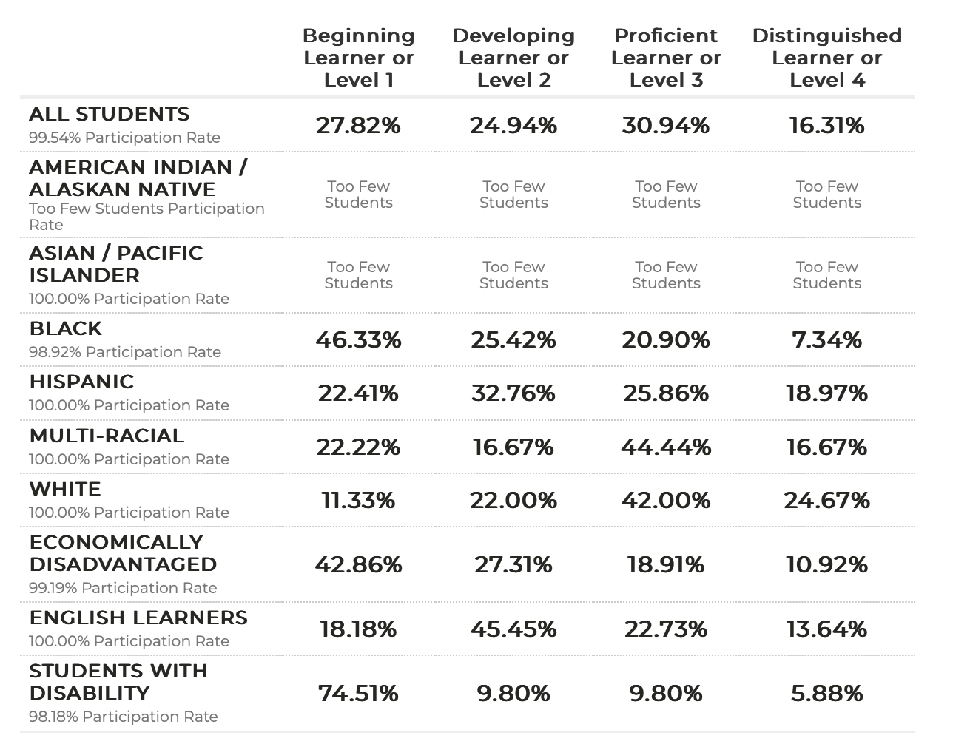
Welch Elementary School ELA GMAS Achievement Levels By Subgroup (2019, 2022, 2023 Percentages)
2019
2022
2023
Gadoe. (n.d.). College and career ready performance index (CCRPI) reports. GADOE CCRPI Reporting System. http://ccrpi.gadoe.org/Reports/Views/Shared/_Layout.html
**GMAS= Georgia Milestones Assessment

Slide 10
46.1
48.2
47.8
40.8
38.9
37.4
38.6
31.4
Percentage of students
EOG Assessment Levels
“K-12 Public Schools Report Card.” Oracle Business Intelligence, gaawards.gosa.ga.gov/analytics/saw.dll?dashboard. Accessed 26 Sept. 2024.

Slide 11
34.9
33.7
33.4
29.8
30.7
28.1
29.3
25.8
24.5
Percentage of Students
15.4
7.4
6.9
Performance Levels
“K-12 Public Schools Report Card.” Oracle Business Intelligence, gaawards.gosa.ga.gov/analytics/saw.dll?dashboard. Accessed 26 Sept. 2024.

Slide 12
70.6
66.9
62.2
57.2
53.4
57.2
57.9
46.2
Percentage of Students
42.1
43.8
35.2
23.6
26.7
26.5
10.1
Subgroups
“K-12 Public Schools Report Card.” Oracle Business Intelligence, gaawards.gosa.ga.gov/analytics/saw.dll?dashboard. Accessed 26 Sept. 2024.

Slide 13
SWD= students with Disabilities
Econ. Disad.= Economically Disadvantaged
ELL= English Language Learners
28.5
20.9
Percentage of Students
14.9
15.0
15.3
10.0
10.2
6.0
Subgroups
“K-12 Public Schools Report Card.” Oracle Business Intelligence, gaawards.gosa.ga.gov/analytics/saw.dll?dashboard. Accessed 26 Sept. 2024.

Slide 14
49.6
46.3
46.3
43.2
44
Percentage of Students
37.9
32.7
33.1
23.5
Grade Levels
“K-12 Public Schools Report Card.” Oracle Business Intelligence, gaawards.gosa.ga.gov/analytics/saw.dll?dashboard. Accessed 26 Sept. 2024.

Slide 15
Progress Data

Slide 16
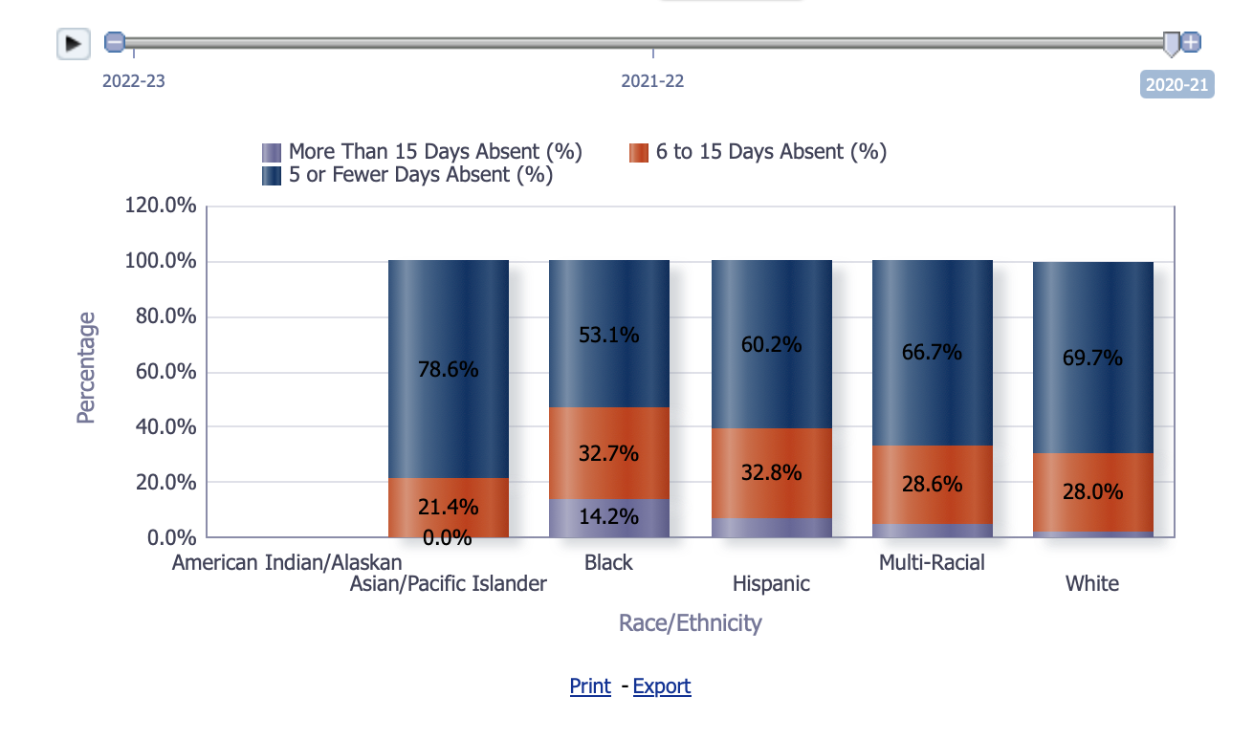
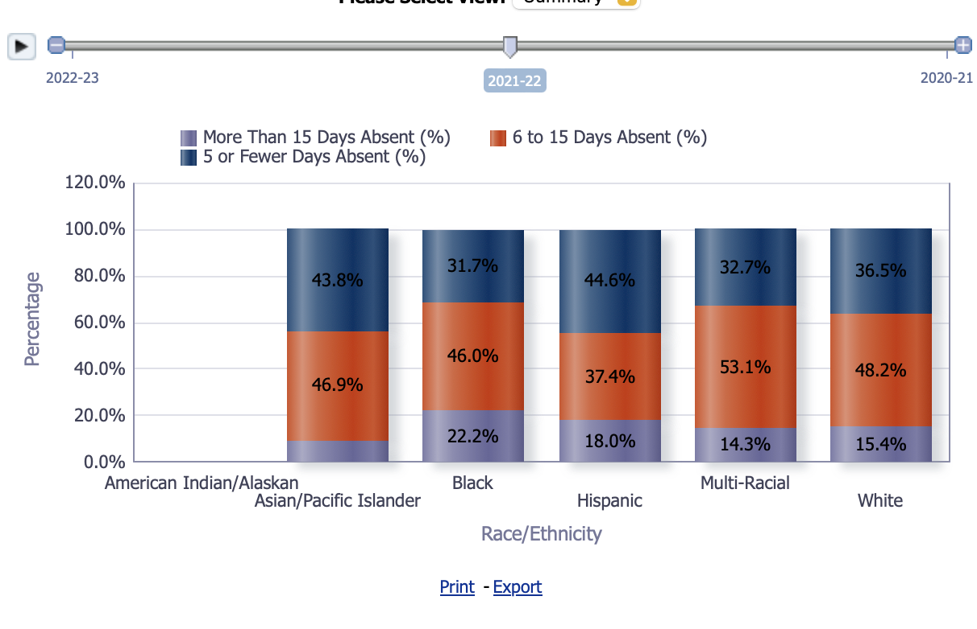
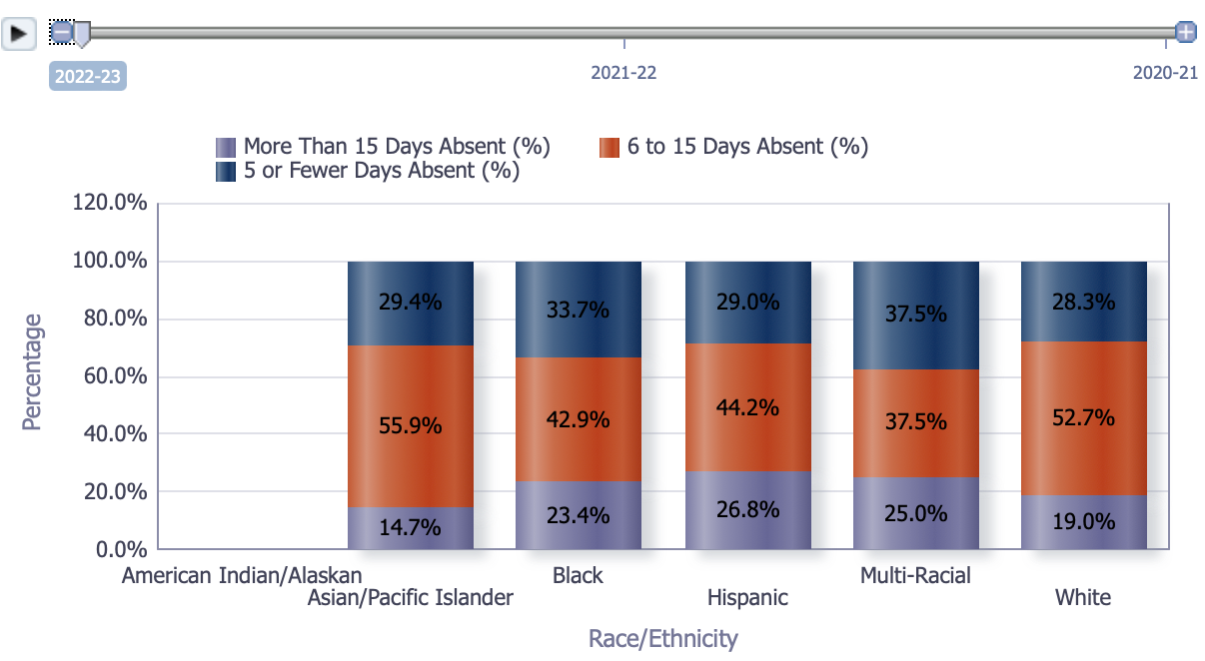
Welch Elementary School Absences by Subgroup for 6 to 15 days absent, 5 or fewer days absent, more than 15 days absent (2020-2023 Percentages)
2020-21
2021-22
2022-23
Oracle Business Intelligence. (n.d.). https://gaawards.gosa.ga.gov/analytics/saw.dll?Dashboard

Slide 17
25
24.1
23.9
20.3
18.4
17.9
Percentage of Students
15.6
15.1
15.3
11.8
12.7
9.4
7
4.8
2.2
Race/Ethnicity Subgroups
“K-12 Public Schools Report Card. Enrollment.” Oracle Business Intelligence, gaawards.gosa.ga.gov/analytics/saw.dll?dashboard. Accessed 27 Sept. 2024.

Slide 18
ED= Economically Disadvantaged
ELL= English Language Learner
SWD= Students with Disabilities
26.8
25.3
20
Percent of Students
15.3
12.4
13.9
11
9.5
3.5
Program Subgroups
“K-12 Public Schools Report Card. Enrollment.” Oracle Business Intelligence, gaawards.gosa.ga.gov/analytics/saw.dll?dashboard. Accessed 27 Sept. 2024.

Slide 19
ED= Economically Disadvantaged
ELL= English Language Learner
SWD= Students with Disabilities
96.3
77.8
80.5
Percent of Total Incidents
68.5
61
51.1
2.2
1.2
Program Subgroup
“K-12 Student Discipline Dashboard.” K12 Student Discipline Dashboard, public.gosa.ga.gov/noauth/extensions/DisciplineDashV1/DisciplineDashV1.html. Accessed 27 Sept. 2024.

Slide 20
81.5
76.8
62.2
Percent of Total Incidents
20
15.6
13
11
8.5
3.7
1.9
2.2
3.7
Race/Ethnicity Subgroups
“K-12 Student Discipline Dashboard.” K12 Student Discipline Dashboard, public.gosa.ga.gov/noauth/extensions/DisciplineDashV1/DisciplineDashV1.html. Accessed 27 Sept. 2024.

Slide 21
4.3
Percentage Rate of Students
1.9
1
0.6
0.1
0.1
Discipline Type
“K-12 Student Discipline Dashboard.” K12 Student Discipline Dashboard, public.gosa.ga.gov/noauth/extensions/DisciplineDashV1/DisciplineDashV1.html. Accessed 27 Sept. 2024.

Slide 22
Perception Data

Slide 23
Welch Elementary School Student Health Survey Data By Grade (2022-2024 Data)
8. Students in my class behave so teachers can teach
 | 3rd |  |  | 4th |  |  | 5th
 | 2022 | 2023 | 2024 | 2022 | 2023 | 2024 | 2022 | 2023 | 2024
Always | 18 | 9 | 15 | 5 | 6 | 7 | 11 | 6 | 7
Never | 15 | 5 | 13 | 5 | 13 | 9 | 12 | 0 | 12
Often | 29 | 30 | 30 | 26 | 22 | 40 | 33 | 14 | 31
Sometimes | 38 | 59 | 59 | 38 | 56 | 75 | 66 | 14 | 66
GADOE Georgia Student Health Survey Dashboard (2024). Student Health Survehttps://app.powe
rbi.com/view?r=eyJrIjoiYWQzMTBhMGItYjE5OS00YjFmLTgyYWItZmQ0YjA2MzczYTI0IiwidCI6IjFhYTU1YzgzLTAzNDMtNGVjYi1iZDM5LWJkN2Y0Mzg3NmJkNyIsImMiOjN9

Slide 24
277
224
189
Percentage of Answers
52
46
29
27
23
4
12
2
3
Survey Results
GADOE Georgia Student Health Survey Dashboard (2024). Student Health Survey https://app.powe
rbi.com/view?r=eyJrIjoiYWQzMTBhMGItYjE5OS00YjFmLTgyYWItZmQ0YjA2MzczYTI0IiwidCI6IjFhYTU1YzgzLTAzNDMtNGVjYi1iZDM5LWJkN2Y0Mzg3NmJkNyIsImMiOjN9

Slide 25
310
250
Percentage of Answers
211
30
30
3
16
15
13
6
3
1
Survey Results
GADOE Georgia Student Health Survey Dashboard (2024). Student Health Survey https://app.powe
rbi.com/view?r=eyJrIjoiYWQzMTBhMGItYjE5OS00YjFmLTgyYWItZmQ0YjA2MzczYTI0IiwidCI6IjFhYTU1YzgzLTAzNDMtNGVjYi1iZDM5LWJkN2Y0Mzg3NmJkNyIsImMiOjN9

Slide 26
330
269
Percentage of Answers
209
21
16
4
4
5
14
3
7
6
Survey Results
GADOE Georgia Student Health Survey Dashboard (2024). Student Health Survey https://app.powe
rbi.com/view?r=eyJrIjoiYWQzMTBhMGItYjE5OS00YjFmLTgyYWItZmQ0YjA2MzczYTI0IiwidCI6IjFhYTU1YzgzLTAzNDMtNGVjYi1iZDM5LWJkN2Y0Mzg3NmJkNyIsImMiOjN9

Slide 27
Welch Elementary School Strengths
The percentage of students at Welch Elementary School scoring Distinguished on the ELA GMAS increased by 3.68 percentage points from 2019-2023 (12.63%-16.31%), (12.63%-2019), (16.31%-2023).
The percentage of students at Welch Elementary School scoring beginning learner on the ELA GMAS decreased by 1.06 percentage points from 2022-2023 (28.88%-27.82%), (28.22%-2022), (27.82%-2023); leading a point of success in more students should proficiency on the ELA GMAS.
The number of students who reported students never behaving in class so the teacher can teach in 3rd grade decreased by 10 students from 2022-2023 (15 students-5 students), (15 students-2022), (5 students-2023).
The number of students who reported students always behaving in class in which provides an opportunity for teachers to teach increased each year for 4th grade students by 1 student each year from 2022-2024 (5 students-7 students), (5 students), (6 students-2023), (7 students-2024); although this increase appears small it shows how the growth trajectory is moving forward to higher numbers and percentages as teachers have worked to connect systems with engaging lessons and classroom management.
ISS (In-School Suspensions) at Welch Elementary School decreased from 2020-21 (0.6%), 2021-22 (0.1%), 2022-23 (0.1%).
Disciplinary referrals decreased for 2+ races from 2021-2023 by 9% and economically disadvantaged students by 2.7%.
Welch Elementary School GMAS Proficient and Distinguished learners increased for 3rd grade from 2020-2023 by 10.5% (2020-21- 32.7%), (2021-22- 33.1%), (2022-23-43.2%).
**GMAS= Georgia Milestones Assessment

Slide 28
Welch Elementary School Areas of Improvement
The percentage of students at Welch Elementary School scoring beginning learner on the ELA GMAS from 2019 to 2022 increased by 5.22 percentage points (23.66%-28.88%), (23.66-2019), (28.88%-2022); Leaving this percentage point to highlight areas in which instruction and interventions can change.
The percentage of students at Welch Elementary School missing more than 15 days of school has increased by 14.4 percentage points from 2020-23(7.9%-22.3%), (7.9%-2020), (22.3%-2023); leaving this percentage point to highlight how COVID-19 may have influenced attendance rates where students increased rates of were absent more than 15 days by 2023.
The percentage of students at Welch Elementary School only having 5 or fewer days absent has decreased by 30.4 percentage points from 2020-2023 (61.7%-31.3%), (61.7%-2020), (31.3%-2023); leaving this percentage point to highlight how attendance is a growing concern for students as the number of students only kissing 5 or fewer days has decreased since 2020-leaving an assumption of COVID-19 to affect this percentage.
The number of students who reported students never behaving in class so teachers can teach in grades 3-5 at Welch Elementary School increased by 16 students from 2023-2024. (18 students-34 students), (18 students-2023), (34 students-2024); leaving this data point to highlight the growing concern of the ability to learn in the classroom as reported by students in grades 3-5.
OSS (Out of School Suspensions) percentages at Welch Elementary School increased from 2020-2023 by 3.3% (2020-21-1), (2021-22-1.9), (2022-23- 4.3)
Disciplinary Referrals for White Students at Welch Elementary School increased from 2020-2023 (2020-21-3.7), (2021-22- 15.6), (2022-23- 8.5)
Students absent 15 days or more increased for Hispanic students at Welch Elementary School from 2020-2023 (2020-21- 7%), (2021-22- 15.1%), (2022-23- 23.9%), and Economically disadvantaged students increased from 2020-2023 by 12.9% (2020-21- 12.4%), (2021-22- 26.8%), )2022-23- 25.3%)
Additionally, ELL (English Language Learners) being 15 or more days absent increased from 2020-2023 by 11.8% (2020-21- 3.5%), (2021-22- 9.5%), (2022-23- 15.3%)
Welch Elementary School ELA EOG (All students) Beginner Learners increased by 6.8% from 2020-2023 (2020-21- 28.1%), (2021-22- 29.3%), (2022-23- 34.9%)
Welch Elementary School ELA EOG (All students) Beginner Learners decreased for Distinguished Learners by 8.5% from 2020-2023 (2020-21- 15.4%), (2021-22- 7.4%), (2022-23- 6.9%)
**GMAS= Georgia Milestones Assessment

Slide 29
Data Intersection
From 2019-2022, the percentage of students who scored Beginning Learner or level 1 on the Elementary ELA GMAS (Georgia Milestones Assessment) increased by 4.16 percentage points (23.66%-27.82%). During the same time, students missing more than 15 days of school increased by 10.4% from 2020-2022. It is possible that the increase in students being absent more that 15 days of school negatively influenced student’s ability to score proficiently on the ELA GMAS. As students are being absent more in a negative growing trend, it could affect the amount of learning material that students comprehend and grasp, in which, can affect their ELA GMAS scores (where students are scoring as beginning learners). For the purpose of this data profile, beginning learner describes learners who have not grasped concepts taught. The increase of student’s absences could result in decreased or negative ELA GMAS (Georgia Milestones Assessment) scores.
**It is important to note that due to COVID-19, students were not administered the GMAS and do not have state-level data for years 2020-2021.
**It is important to note that GOSA-GA only reported years 2020-2023 for attendance data, leaving 2019 to not be accounted for.

Slide 30
Data Intersection
Additionally, From 2020-2023 disciplinary referrals decreased for Black students by 4.9% (2020-21- 81.5%), (2021-22- 62.2%), (2022-23- 76.8%). At the same time, Black students at Welch Elementary School from the years of 2020-2023 taking the ELA EOG assessment scoring proficient and distinguished increased by 16.6% (2020-21- 10.1%), (2021-22- 23.6%), (2022-23- 26.7%). It is possible that the decrease in disciplinary referrals for black students led to the increased in students scoring proficient and distinguished on the ELA EOG assessment. As students are in class more and following the rules and expectations of the school, they are given disciplinary referrals less. Within this, students can maximize instructional time by engaging in lessons which has led to more black students scoring proficient and distinguished on the ELA EOG assessment. For the purpose of this intersection data, proficient learners refers to learners who are scoring as ” on grade level” and distinguished as “above grade level” learners on the ELA EOG assessment.
**ELA= English Language Arts
**EOG= End of Grade

Slide 31
References:
Fall and Spring school enrollment data by grade level. Data source retrieved from https://gaawards.gosa.ga.gov/analytics/saw.dll?dashboard
Gadoe. (n.d.). College and Career Ready Performance Index (CCRPI) reports. GADOE CCRPI Reporting System. http://ccrpi.gadoe.org/Reports/Views/Shared/_Layout.html
Gadoe. (n.d.). College and Career Ready Performance Index (CCRPI) reports. GADOE CCRPI Reporting System. http://ccrpi.gadoe.org/Reports/Views/Shared/_Layout.html
GADOE Georgia Student Health Survey Dashboard (2024). Student Health Survey https://app.powerbi.com/view?r=eyJrIjoiYWQzMTBhMGItYjE5OS00YjFmLTgyYWItZmQ0YjA2MzczYTI0IiwidCI6IjFhYTU1YzgzLTAzNDMtNGVjYi1iZDM5LWJkN2Y0Mzg3NmJkNyIsImMiOjN9
Oracle Business Intelligence. (n.d.). https://gaawards.gosa.ga.gov/analytics/saw.dll?Dashboard
“K-12 Public Schools Report Card.” Oracle Business Intelligence, gaawards.gosa.ga.gov/analytics/saw.dll?dashboard. Accessed 26 Sept. 2024.
“K-12 Public Schools Report Card. Enrollment.” Oracle Business Intelligence, gaawards.gosa.ga.gov/analytics/saw.dll?dashboard. Accessed 27 Sept. 2024.
“K-12 Student Discipline Dashboard.” K12 Student Discipline Dashboard, public.gosa.ga.gov/noauth/extensions/DisciplineDashV1/DisciplineDashV1.html. Accessed 27 Sept. 2024.
The Governor’s Office of Student Achievement (2024, January) Student and School Demographic Data https://gaawards.gosa.ga.gov/analytics/saw.dll?PortalPages

