Slide 1
Comprehensive Data Profile
(30-60 Day Improvement Plan)
Chattahoochee Hill Charter School

Slide 2
Chattahoochee Hill Charter School
Introduction
Chattahoochee Hills Charter School is in Fairburn, Georgia.
Chattahoochee Hills Charter School serves approximately 557 students from Kindergarten to Eighth grade.
Chattahoochee Hills Charter School has 54.9 percent of the students economically disadvantaged and 11.5 percent of students with disabilities. Additionally, Chattahoochee Hill Charter serves under 10 percent English Language Learners.
Chattahoochee Hills Charter School overall content mastery for elementary is 42.9 percent points lower than its district. Its student readiness is just below the district’s percent points.
Chattahoochee Hills Charter School overall content mastery for Middle is 23.7 percent points lower than its district. Its student readiness is just below the district’s percent points.
Chattahoochee Hills Charter School has a 3-star School Climate Rating
Data retrieved from: https://ccrpi.gadoe.org/Reports/Views/Shared/_Layout.html
Notes:
As Chattahoochee Hills Charter School is a K-8 charter school data will be separated into two subsections- Elementary and Middle. Some data may account for the whole school.

Slide 3
Demographic Data

Slide 4
Chattahoochee Hills Charter School Fall/Spring Enrollment
2023-24
Number of students
Grade Level
K-12 Public Schools Report Card.” Oracle Business Intelligence, https://gaawards.gosa.ga.gov/analytics/saw.dll?dashboard

Slide 5
Chattahoochee Hills Charter School Enrollment by Race/Ethnicity
2023-24
87
Percentage of students
6
3
3
Race/Ethnicity
K-12 Public Schools Report Card.” Oracle Business Intelligence, https://gaawards.gosa.ga.gov/analytics/saw.dll?dashboard

Slide 6
Chattahoochee Hills Charter School Enrollment by Subgroups
2023-24
70
50
50
Percentage of Students
9.4
1.0
Subgroups
K-12 Public Schools Report Card.” Oracle Business Intelligence, https://gaawards.gosa.ga.gov/analytics/saw.dll?dashboard

Slide 7
Chattahoochee Hills Charter School Staff Demographics
2023-24
34
34
Number of personnel
6
6
0
0
0
0
K-12 Public Schools Report Card.” Oracle Business Intelligence, https://gaawards.gosa.ga.gov/analytics/saw.dll?dashboard

Slide 8
Achievement Data

Slide 9


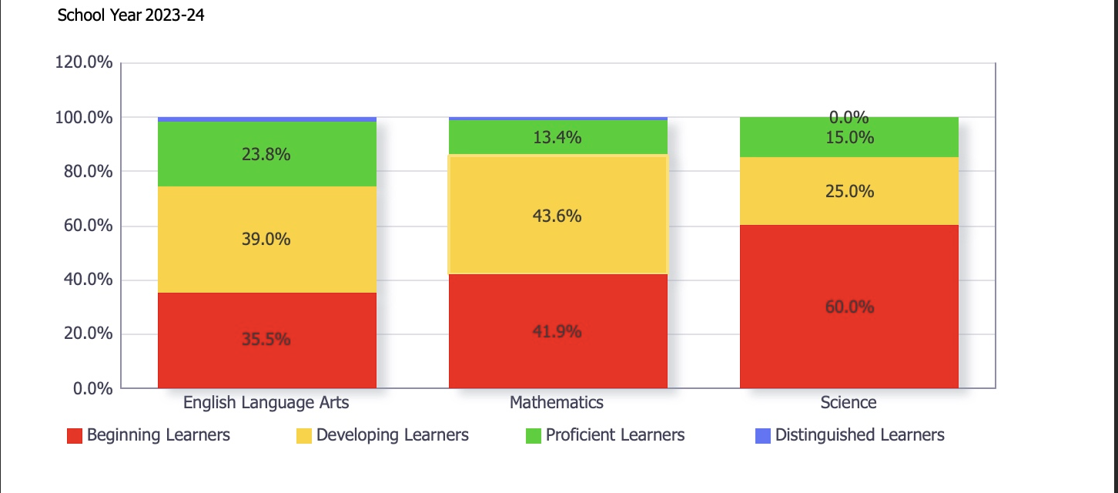

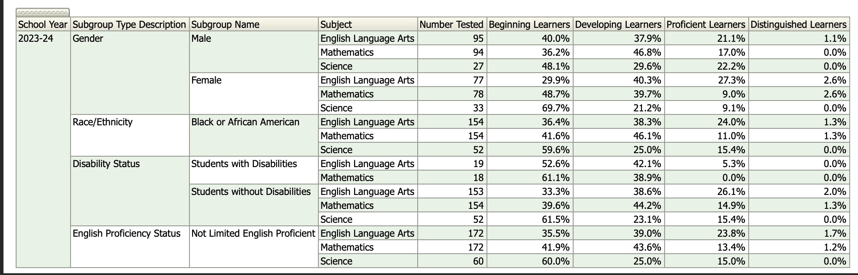
Chattahoochee Hills Charter School ELA GMAS Achievement Levels by Subgroups
z
Oracle Business Intelligence. (n.d.). https://gaawards.gosa.ga.gov/analytics/saw.dll?Dashboard

Slide 10
Elementary ELA EOG for CHCS, District, State
(Proficient and Distinguished)
2023-24
Percentage of students
EOG Assessment Levels
K-12 Public Schools Report Card.” Oracle Business Intelligence, https://gaawards.gosa.ga.gov/analytics/saw.dll?dashboard

Slide 11
Middle ELA EOG for CHCS, District, State
(Proficient and Distinguished)
2023-24
Percentage of students
Data retrieved from: https://ccrpi.gadoe.org/Reports/Views/Shared/_Layout.html

Slide 12
Elementary Math EOG for CHCS, District, State
(Proficient and Distinguished)
2023-24
Percentage of students
Data retrieved from: https://ccrpi.gadoe.org/Reports/Views/Shared/_Layout.html

Slide 13
Middle Math EOG for CHCS, District, State
(Proficient and Distinguished)
2023-24
Percentage of students
Data retrieved from: https://ccrpi.gadoe.org/Reports/Views/Shared/_Layout.html

Slide 14
CHCS Elementary English Language Arts (ELA) EOG-All Students
2023-34
59.02
41.71
44
38.86
Percentage of students
34.86
26.23
24.57
13.14
14.75
1.71
1.14
Data retrieved from: https://ccrpi.gadoe.org/Reports/Views/Shared/_Layout.html

Slide 15
CHCS Middle English Language Arts (ELA) EOG-All Students
2023-34
Percentage of students
Data retrieved from: https://ccrpi.gadoe.org/Reports/Views/Shared/_Layout.html

Slide 16
CHCS Elementary EOG by Subgroups Proficient and Distinguished Levels
2023-24
Percentage of students
Data retrieved from: https://ccrpi.gadoe.org/Reports/Views/Shared/_Layout.html

Slide 17
CHCS Middle EOG by Subgroups Proficient and Distinguished Levels
2023-24
Percentage of students
Data retrieved from: https://ccrpi.gadoe.org/Reports/Views/Shared/_Layout.html

Slide 18
CHCS 2023-24 GMAS Data by Grade Level (Proficient and Distinguished Levels)
Percentage of students
Data retrieved from: https://ccrpi.gadoe.org/Reports/Views/Shared/_Layout.html

Slide 19
Process Data

Slide 20
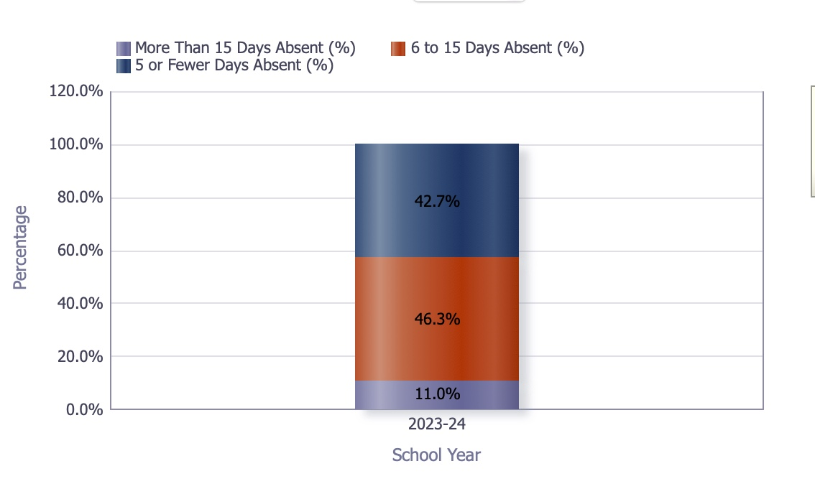
CHCS Absences by Subgroup for 6 to 15 days absent, 5 or fewer days absent, and more than 15 days absent (2023-24 percentages)
Oracle Business Intelligence. (n.d.). https://gaawards.gosa.ga.gov/analytics/saw.dll?Dashboard

Slide 21
CHCS Attendance with More Than 15 Days Absent
2023-24
Percentage of students
Race/Ethnicity Subgroups
Oracle Business Intelligence. (n.d.). https://gaawards.gosa.ga.gov/analytics/saw.dll?Dashboard

Slide 22
CHCS Absenteeism by Program Subgroup (15 days or more)
2023-24
ED= Economically Disadvantaged
ELL= English Language Learner
SWD= Students with Disabilities
Percentage of students
Program Subgroups
Oracle Business Intelligence. (n.d.). https://gaawards.gosa.ga.gov/analytics/saw.dll?Dashboard

Slide 23
CHCS Percentage of Disciplinary Referrals by Subgroup
2023-24
Percentage of students
https://public.gosa.ga.gov/noauth/extensions/DisciplineDashV1/DisciplineDashV1.html

Slide 24
CHCS Percentage of Disciplinary Referrals by Subgroup
2023-24
ED= Economically Disadvantaged
ELL= English Language Learner
SWD= Students with Disabilities
Percentage of students
Program Subgroup
https://public.gosa.ga.gov/noauth/extensions/DisciplineDashV1/DisciplineDashV1.html

Slide 25
Out-of-School Suspension Rates
2023-24
Percentage of students
https://public.gosa.ga.gov/noauth/extensions/DisciplineDashV1/DisciplineDashV1.html

Slide 26
Perception Data

Slide 27
Elementary Georgia Student Health Survey Question Results
3. My School wants me to do Well
Year: 2023-24
Number of students
Grade level
GaDOE. (n.d.). Georgia Student Health Survey. Survey Results. https://apps.gadoe.org/GSHSSurveyResults/Pages/default.aspx

Slide 28
Elementary Georgia Student Health Survey Question Results
8. Students in my class behave so teachers can teach
Year: 2023-24
Number of students
GaDOE. (n.d.). Georgia Student Health Survey. Survey Results. https://apps.gadoe.org/GSHSSurveyResults/Pages/default.aspx

Slide 29
Middle Georgia Student Health Survey Question Results
2. I feel like I fit in at my school
Year: 2023-24
Number of students
GaDOE. (n.d.). Georgia Student Health Survey. Survey Results. https://apps.gadoe.org/GSHSSurveyResults/Pages/default.aspx

Slide 30
Middle Georgia Student Health Survey Question Results
58. The behaviors in my classroom allow the teacher to teach so I can learn
Year: 2023-24
Number of students
GaDOE. (n.d.). Georgia Student Health Survey. Survey Results. https://apps.gadoe.org/GSHSSurveyResults/Pages/default.aspx

Slide 31
Data Analysis

Slide 32
Strengths
ED= Economically Disadvantaged
ELL= English Language Learner
SWD= Students with Disabilities
There is clear and consistent growth in middle grades. Although middle grades content mastery is about 23.7 percent below the district, it is particularly stronger than the elementary level gap of 42.9 percentage points; indicating a relatively stronger performance in middle grades. With this, it presents a potential leverage for academic coaching and professional supports.
There is a diverse student body with a balanced subgroup distribution. With a balanced mixture of subgroups ( 50% male, 50% female, 9.4% of students with disabilities, and 1% ELLs), opportunities to design targeted instructional interventions (i.e. flex ability grouping) become manageable in scope and size.
CHCS produces a positive school culture with a 3-star climate rating indicating moderately strong and positive relationships, safety, and engagement. Additionally, this rating indicates the improvement of academics as students tend to learn better when the environment is conducive to their learning needs and preferences.
​CHCS demonstrates a commitment to fostering a positive school climate by actively participating in the Georgia Student Health Survey, utilizing the results to inform and enhance strategies that support student well-being and engagement.​

Slide 33
Weaknesses
ED= Economically Disadvantaged
ELL= English Language Learner
SWD= Students with Disabilities
There are significant gaps in content mastery on the Elementary level. The elementary content mastery is about 42.9 percentage points lower than the district, indicating a critical need for foundational literacy and numeracy intervention in early grades.
Additionally, there is a low achievement in ELA and Math across grade levels. CHCS proficiency levels in ELA and Math are significantly low compared to the district. The GMAS data showed 34 percent of elementary students performing at proficient or above in ELA; however, still lower than the district at 56.85 percent.
There are disparities in subgroup performance indicating that achievement data by subgroup shows gaps in proficiency levels, specifically disadvantaged students (54.9 percent) and students with disabilities (11.5 percent) leading to a critical need for strong MTSS interventions that can target foundational gaps in skills and special education supports.
Relating to absenteeism, CHCS reports a high percentage of students absent more than 15 days, specifically among economically disadvantaged and SWD subgroups. As chronic absenteeism can negatively impact academic achievement, student-centered incentives and family partnerships are key to strengthening this area.

Slide 34
30-60 Day Plan for Improvement

Slide 35
Areas of Immediate Opportunities
ED= Economically Disadvantaged
ELL= English Language Learner
SWD= Students with Disabilities
Elementary students are performing 42.9% lower than the district in content mastery. Therefore, it is important to establish and launch intensive K-5 literacy and math interventions. Suggestions:
Small flex grouping by skills and abilities
MTSS Tier II and III supports that focus on phonological and phonemic awareness (i.e. the use of Haggerty, 95 Core Phonics) and numeracy foundational and conceptual gaps (i.e. HMH math)
Maximize instructional time where tailored supports can be given regardless of level.
Addressing chronic absenteeism; it can be a challenge to ensure that students are there and ready to learn. There are high rates of students missing 15 or more days of school, especially among program subgroups including ED and SWD. With this, it is important to focus on launching an attendance task force to track, engage, and follow up with families. Suggestions:
Use student centered incentives (i.e. survey students to inquire what motivates them)
Conduct home visits to show families the wrap around support they have available to them.
Partner with the community to improve daily attendance.
There is a lack of proficiency in ELA and Math across grade levels. Both elementary and middle school students are underperforming compared to the district/state averages. These gaps present a reduction in readiness as students matriculate into high school. Suggestion:
Conduct weekly data cycles through PLCs (professional learning communities) using a variety of benchmark and formative assessments to drive instruction.
Create and implement an intensive tutoring camp as an extension to the school day to tackle weak academic areas.
For students who struggle beyond grade-level content; partnering with interventionists to create plans to address foundational gaps.

Slide 36
Areas of Immediate Opportunities Plan
ED= Economically Disadvantaged
ELL= English Language Learner
SWD= Students with Disabilities
First 30 days (Addressing content mastery area of concern):
Launch: Academic Spiral Skills Assessment (this assessment will test student’s knowledge on state standards they have been taught and on standards that they haven been exposed to, to drive instructional decisions)
**If it is close to the middle of the year, then do MOY Benchmark testing**
Professional development opportunities for teachers who need additional pedagogical understanding in foundational skills:
- Science of Reading Foundations (with Heggerty + 95 Core Phonics)
Math Intervention Planning using HMH Math
Implement:
- Small flex groups for daily intervention (based on diagnostic/ Spiral skills assessment data)
Tier II and Tier III MTSS cycles focused on phonological awareness, decoding, number sense
Next 30 Days
Monitor & Adjust:
- Begin biweekly data checks for K–5 groups using PLC time.
Adjust groupings every 4 weeks based on progress
Professional Development:
- Lesson Planning for Differentiated Intervention
Using Wonders and i-Ready to Scaffold Tier I Reading
Instructional Strategy:
- Use walkthroughs and coaching to monitor fidelity of small group instruction.
First 30 days (Addressing chronic absenteeism for ED & SWD subgroups):
Form Attendance Task Force: Include counselor, social worker, admin, teacher leads.
Professional Development:
- Using SEL (Rethink Ed) to Build Belonging and Engagement
Attendance Messaging & Family Engagement Strategies
Implement:
- Daily attendance dashboard for quick alerts on students hitting 5+ absences.
- Student motivation survey to design tailored attendance incentives.
- Begin weekly calls and check-ins with families of chronically absent students.
Next 30 Days
Launch: Attendance Campaign
- “Everyday Counts” week with classroom competitions.
- Community partnerships for reward sponsorship
Professional development opportunities:
- Trauma-Informed Practices for Absenteeism
- Building Tier I SEL Routines (Rethink Ed)
Implement:
Begin home visits for students missing 10+ days.
Provide wraparound service menus to families (transportation, clothing, food).
First 30 days (Addressing low ELA/Math proficiency):
Launch: Professional Learning Communities (PLCs) start weekly data cycles focused on Professional development opportunities for teachers who need additional pedagogical understanding in foundational skills:
Professional development:
- Using Data to Inform Small Group Instruction
- Aligning Formative Assessments to State Standards
Implement (tutoring extension program):
Identify students performing at “Beginning” level.
Develop after-school tutoring schedule with certified staff.
Next 30 Days
Launch: Tutoring Camp (After-School)
- Prioritize students with lowest proficiency scores.
Professional Development:
- Remediation Strategies for Below-Level Learners
- Effective Questioning and Feedback for Struggling Students
Progress Monitor Tutoring Effectiveness:
Track via pre/post assessments every 4 weeks.

Slide 37
Suggested Academic Curricula/Resources to Use (Elementary and Middle Grades)
Heggerty (Phonemic awareness) | 95 Core Phonics | MTSS Intervention support (Fast Bridge, iReady) | Wonders (Reading skills) | SEL- Rethink ED
Ideal for Tier II intervention. Heggerty supports foundational phonological awareness critical for early literacy. For students who scored in the range of “needs support” reading range, Heggerty can be used in either small group instruction or strategic flex grouping to target phonemic awareness skills. Middle School focused: Newsela- an adaptive platform with leveled, high-interest non-fiction articles. As Newsela provides tailored text to student’s Lexile levels, at CHCS, this program can be used for bellringers, cross-curricular reading (i.e. Scientific texts and historical texts), and Tier II and III interventions. **It is important to note that this resource can be utilized for special education supports as well** How can this help CHCS? As Heggerty targets phonemic and phonological awareness, students identified within the lower 42.9% of proficiency compared to the district can benefit from Tier I mini lessons and adaptable Tier II and III supports. | Ideal for Tier I instruction as an introduction to the reading block. Although it is ideal for Tier I instruction, it can be used during intervention blocks in grades 1-5. Intended to build critical phonics skills through explicit instruction, students can gain success in skills including decoding, encoding, and written dictation. **It is important to note that this resource can be utilized for special education supports** How can this help CHCS? As 95 Core Phonics survey identifies the specific phonics pattern students have mastered or missed, tier II and Tier III instruction can be implemented to address severe phonics gaps (e.g., short vowels, digraphs, vowel teams, multisyllabic word reading) for students at CHCS. Through structured intervention times of the day, interventionists can work with students one-on-one or in small groups. Middle School Focused: Although this program is typically designed for early elementary grades, it can be beneficial for students with foundational gaps. In Tier I instruction, Teachers can target the exact phonics skill deficits, rather than reteaching all early literacy concepts. For Tier II/III intervention support, interventionists can help close the decoding gap for students reading below grade level. | FastBridge: (Academic/behavior) Ideal for Tier III intervention screening and progress monitoring in elementary and middle school. As FastBridge identifies student’s academic and social-emotional behavior needs, this platform can help bridge the gap in understanding and help students gain confidence to approach grade level content and age-appropriate behavior. FastBridge is not only used academically but has a behavioral component to help address behavioral needs in Tier II and Tier III phases of intervention. **It is important to note that this resource can be utilized for special education supports as well** iReady: As iReady is an adaptive diagnostic tool with individualized and teacher-led instructional components, teachers can use this tool during Tier I and II instruction while interventionists can adapt the program to examine foundational gaps and provide multiple means of individualized practice. How can this help CHCS? As iReady can track progress for SWD and ED students, instruction can be modified and accommodated to fit their academic level as nearly 55 percent of CHCS students are economically disadvantaged and over 11 percent of students receive special education services. | Ideal for Tier 1 instruction but has Tier II and III components to address foundational gaps in skills that interventionists can utilize. Wonders provides a comprehensive, research-based curriculum that builds reading fluency, comprehension, and vocabulary through whole-group, small group, and independent reading instruction. Additionally, Wonders focuses on gradual skill progression aligned with state standards. How can this help CHCS? Only 26 percent of elementary students are proficient or above in ELA, which is significantly below the district average of 56.85 percent. Tier I instruction across grade levels can be used to close foundational gaps. Additionally, Wonders can be paired with programs like Heggerty and 95 Core Phonics for Tier II and II interventions. **It is important to note that this resource can be utilized for special education supports as well** | Ideal for Tier I, II, and III instruction and is a comprehensive educational platform that provides evidence-based solutions to support the academic, behavioral, and social-emotional development of students. How can this help CHCS? As Rethink ED offers a range of resources designed to create healthier school climates, enhance mental health awareness, and empower educators with effective instructional tools, it is helpful for CHCS as there are high rates of absenteeism (absent over 15 days) among ED and SWD student subgroups. Through Rethink ED, student connections are built through daily SEL check-ins, emotional regulation strategies, and lessons on self-awareness and responsibility. **It is important to note that this resource can be utilized for special education supports as well**

Slide 38
Suggested Professional Development Opportunities
First 30 days: Foundational Response to Urgent Needs
Through a 4-week Cycle, here are PD opportunities:
Week 1-2 Focus: Foundational Literacy & Math Interventions
PD- The Science of Reading- Applying Heggerty and 95 Core Phonics
- Direct focus: Phonemic awareness, decoding, Tier II/III supports
PD: Math Fluency and Conceptual Understanding (K–8)
- Direct focus: Using HMH Math for building numeracy and flexible grouping
Week 3 Focus: MTSS Kickoff & Tiered Support Systems
PD: Building an Effective MTSS Framework
- Direct focus: Tier I differentiation, Tier II/III intervention strategies, documentation
PD: Creating Skill-Based Intervention Blocks
- Direct focus: Scheduling and managing time for small-group instruction
Week 4 Focus: SEL & Attendance Intervention Foundations
PD: Rethink Ed SEL Training – Daily Routines and Check-ins
- Direct focus: Embedding SEL lessons and emotional check-ins into instruction
PD: Launching an Attendance Task Force
- Direct focus: Attendance data tracking, family engagement strategies, student incentives
Next 30 days: Data Use, Differentiation & Inclusive Practices
Week 5-6 Focus: Data-Driven Instruction & PLCs
PD- Using iReady and Benchmark Data in Weekly PLCs
- Direct focus: Analyzing diagnostic data, setting goals, creating intervention groups
PD: Creating Instructional Plans from Formative Assessments
- Direct focus: Aligning small group instruction to student data
Week 7 Focus: Differentiation & Inclusion
PD: Co-Teaching and Inclusion Strategies for SWDs
- Direct focus: Supporting 11.5% SWD population with UDL (Universal Design Learning) and scaffolded instruction
PD: Differentiated Instruction for High-Need Subgroups
- Direct focus: Culturally responsive teaching and small group management
Week 8 Focus: SEL & Behavior Support Expansion
PD: Trauma-Informed Strategies & Restorative Practices
- Direct focus: Addressing discipline trends and strengthening student-teacher relationships
PD: Using Rethink Ed for Behavior Coaching and Conflict Resolution
- Direct focus: Targeted supports for at-risk students (ED, SWD)

Slide 39
References
GaDOE. (n.d.). Georgia Student Health Survey. Survey Results. https://apps.gadoe.org/GSHSSurveyResults/Pages/default.aspx
Oracle Business Intelligence. (n.d.). https://gaawards.gosa.ga.gov/analytics/saw.dll?Dashboard
Gadoe. (n.d.). College and career ready performance index (CCRPI) reports. GADOE CCRPI Reporting System. https://ccrpi.gadoe.org/Reports/Views/Shared/_Layout.html
K-12 Public Schools Report Card.” Oracle Business Intelligence, https://gaawards.gosa.ga.gov/analytics/saw.dll?dashboard

